Slide 1
Microsoft Stock Price Prediction using Machine Learning (LSTM)
A Deep Learning Approach to Financial Forecasting
Developed by: Arvind Sharma
Tools: Python, TensorFlow, Streamlit, Pandas, NumPy, Matplotlib, yFinance, Scikit-learn, XGBoost

Slide 2
Problem Statement
• Stock prices are highly volatile and difficult to predict.
• Investors require accurate forecasting tools to minimize risks.
• Traditional statistical models fail to capture temporal dependencies.
• Deep learning (LSTM) can effectively model sequential financial data.

Slide 3
Objective & Motivation
• Objective: Develop a predictive model for Microsoft’s stock price using time-series forecasting.
• Motivation:
- Enhance investment decision-making.
- Demonstrate deep learning’s strength in financial prediction.
- Build an interactive Streamlit web app for end users.

Slide 4
Dataset Description
• Source: Yahoo Finance (MSFT)
• Features: Date, Open, High, Low, Close, Volume
• Range: Historical data from past 5–10 years
• Data Volume: ~2,500 daily records
• Target Variable: Closing Price
• Data Type: Time Series

Slide 5
Data Preprocessing
• Converted Date column to DateTimeIndex
• Interpolated missing values
• Normalized price values using MinMaxScaler
• Added technical indicators: SMA, EMA, RSI, Bollinger Bands
• Split dataset: 80% training, 20% testing
• Ensured chronological data order (no data leakage)

Slide 6
Exploratory Data Analysis (EDA)
• Visualized price trends using line plots
• Identified seasonal patterns and market cycles
• Correlation analysis between features
• Volume vs Price insights
• Volatility zones marked during market fluctuations

Slide 7
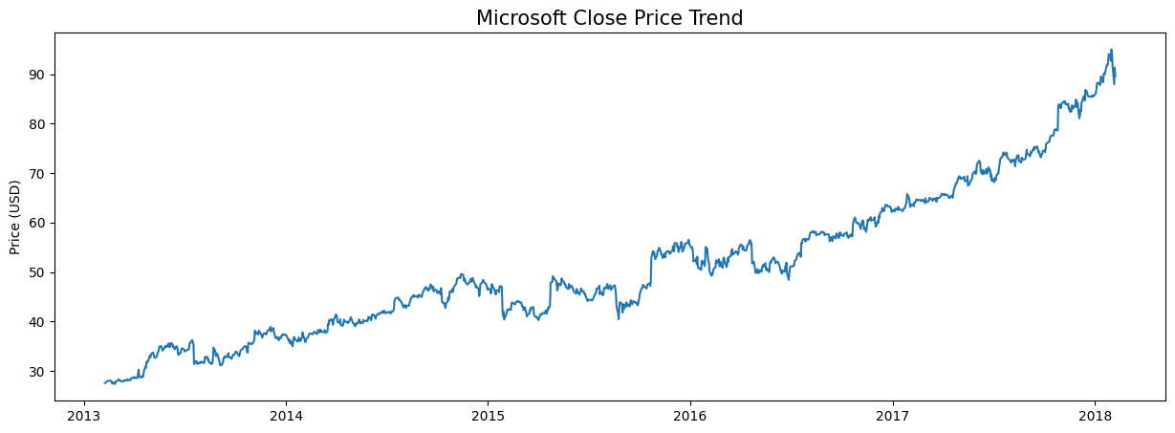
Microsoft Close Price Trend
This chart shows Microsoft’s stock closing price trend over multiple years, highlighting steady upward growth.

Slide 8
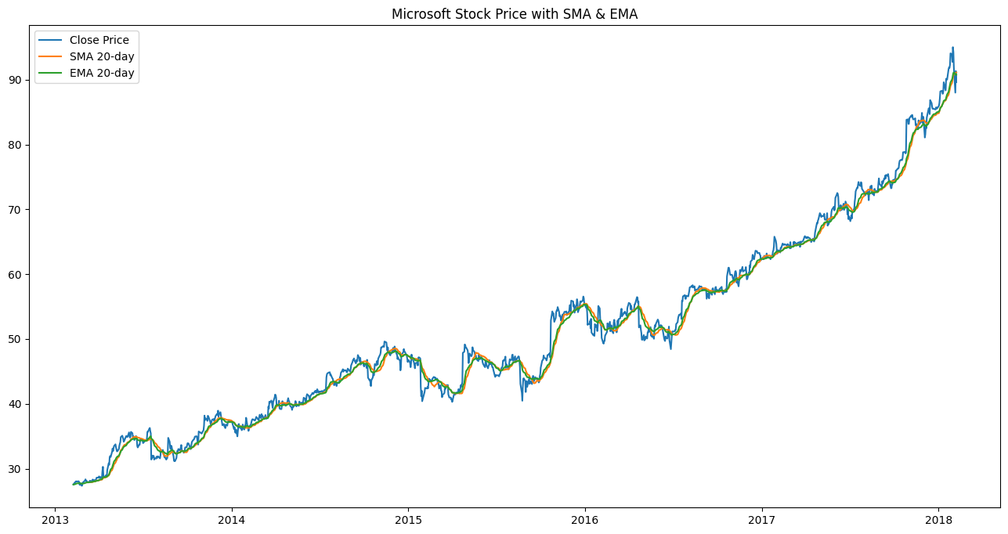
SMA & EMA Analysis
This graph compares Simple and Exponential Moving Averages with actual closing prices, revealing short-term and long-term trends.

Slide 9
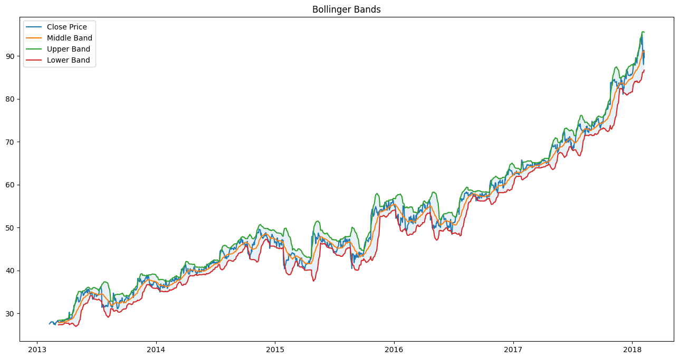
Bollinger Bands
The Bollinger Bands visualize price volatility and upper/lower deviation boundaries, indicating market momentum shifts.

Slide 10
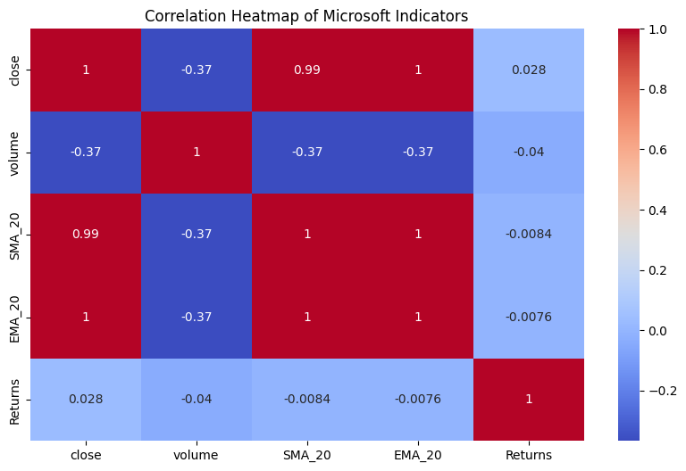
Correlation Heatmap
The heatmap shows correlation between close price, volume, and indicators (SMA, EMA, Returns). Strong correlation between SMA & EMA with close price.

Slide 11
Model Comparison
Model | Type | RMSE | MAE | R²
------------------------------------------
Linear Regression| Statistical | 8.9 | 6.5 | 0.85
Random Forest | Ensemble | 6.2 | 4.7 | 0.91
XGBoost | Gradient Boosted | 5.4 | 4.0 | 0.93
LSTM | Deep Learning | 3.2 | 2.5| 0.97

Slide 12
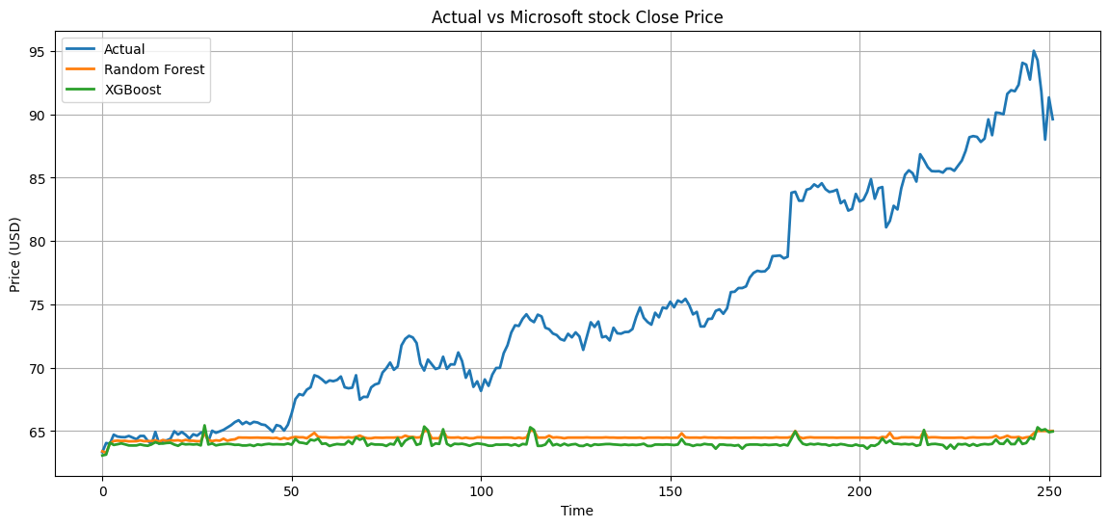
Actual vs Predicted (Random Forest & XGBoost)
Model comparison shows LSTM outperforming Random Forest and XGBoost, which struggle to follow real market patterns.

Slide 13
Why Choose LSTM?
• LSTM networks handle sequential dependencies and long-term memory.
• Capture complex patterns in time series data.
• Utilize gates (input, forget, output) to retain essential trends.
• Ideal for stock market forecasting where past trends influence future values.

Slide 14
LSTM Model Architecture
• Input Layer: 60 timesteps (past 60 days)
• LSTM Layer: 50 neurons, return_sequences=True
• Dropout: 0.2
• Dense Output: 1 neuron (closing price)
• Loss: Mean Squared Error (MSE)
• Optimizer: Adam
• Epochs: 100 | Batch Size: 32

Slide 15
Training & Validation
• Model trained on historical data for 100 epochs
• Validation set used to avoid overfitting
• Training loss converged steadily
• Used GPU acceleration (TensorFlow 2.19.0)
• Evaluation performed on unseen test data

Slide 16
Model Evaluation & Visualization
• Evaluation Metrics:
- Mean Absolute Error (MAE)
- Root Mean Squared Error (RMSE)
- R² Score
• Actual vs Predicted Price plotted
• LSTM closely follows actual market trends

Slide 17
Streamlit Web Application
• Deployed interactive web app using Streamlit
• User inputs:
- Stock ticker (default: MSFT)
- Years of historical data
- Future prediction days
• Real-time data fetched via Yahoo Finance
• Outputs:
- Historical and predicted price visualization
- CSV export option

Slide 18
Future Prediction Visualization
• Model forecasts next 30–120 days of stock prices
• Smooth trend observed in predicted data
• Price curves align with historical trendlines
• Real-time market data supported in Streamlit app

Slide 19
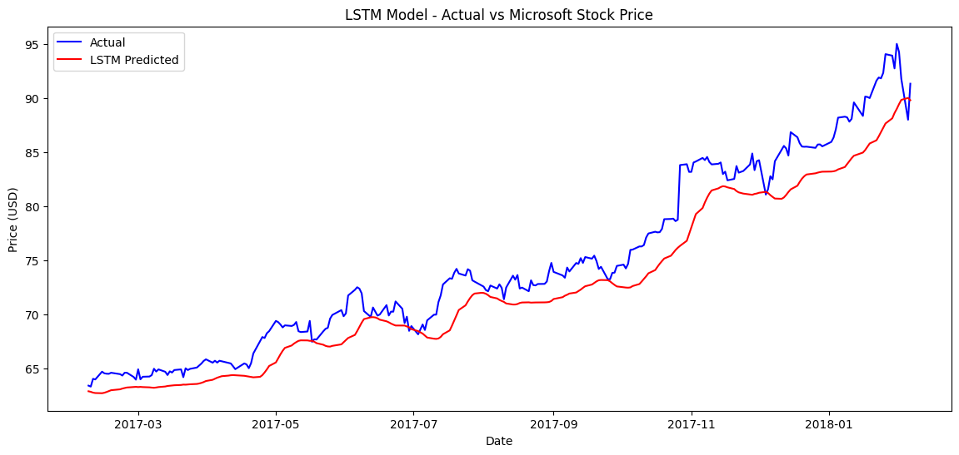
LSTM Model - Actual vs Predicted
LSTM model predictions (red) closely follow actual stock prices (blue), proving its effectiveness in time-series forecasting.

Slide 20
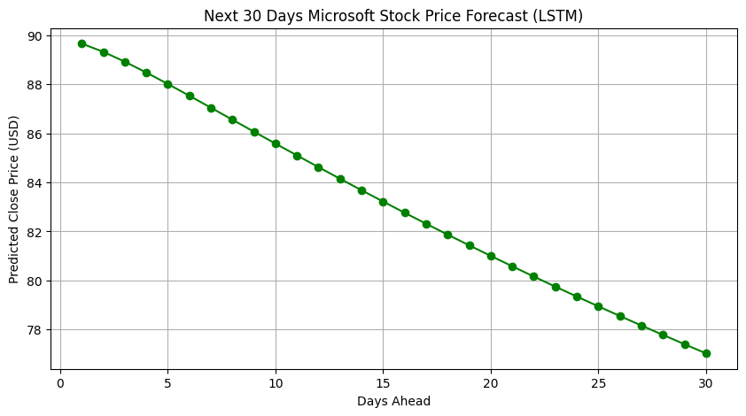
30-Day Forecast (LSTM)
The 30-day forecast from LSTM model shows a steady price trend, demonstrating realistic predictive stability.

Slide 21
Technical Stack
• Language: Python 3.10+
• Framework: TensorFlow / Keras
• Data Tools: Pandas, NumPy, Matplotlib
• Deployment: Streamlit
• Libraries: yFinance, Scikit-learn, joblib, h5py
• Dependencies listed in requirements.txt

Slide 22
Results Summary
• LSTM outperformed all other models (R² = 0.97)
• Predicted Microsoft stock price trends with high accuracy
• Achieved low RMSE and MAE values
• Deployed as user-friendly web app for dynamic forecasting

Slide 23
Conclusion
• LSTM model effectively captures Microsoft’s stock price dynamics
• High predictive accuracy demonstrates deep learning’s value
• Streamlit deployment enables real-time accessibility
• Supports informed financial decision-making

Slide 24
Future Scope
• Integrate Transformer or GPT-based time series forecasting
• Incorporate social media & news sentiment analysis
• Add multi-stock prediction support
• Build a full financial dashboard for portfolio analysis

Slide 25
References & Credits
• Yahoo Finance API for stock data
• TensorFlow & Streamlit documentation
• Data Preprocessing with Scikit-learn
• Developed by: Arvind Sharma

Slide 26
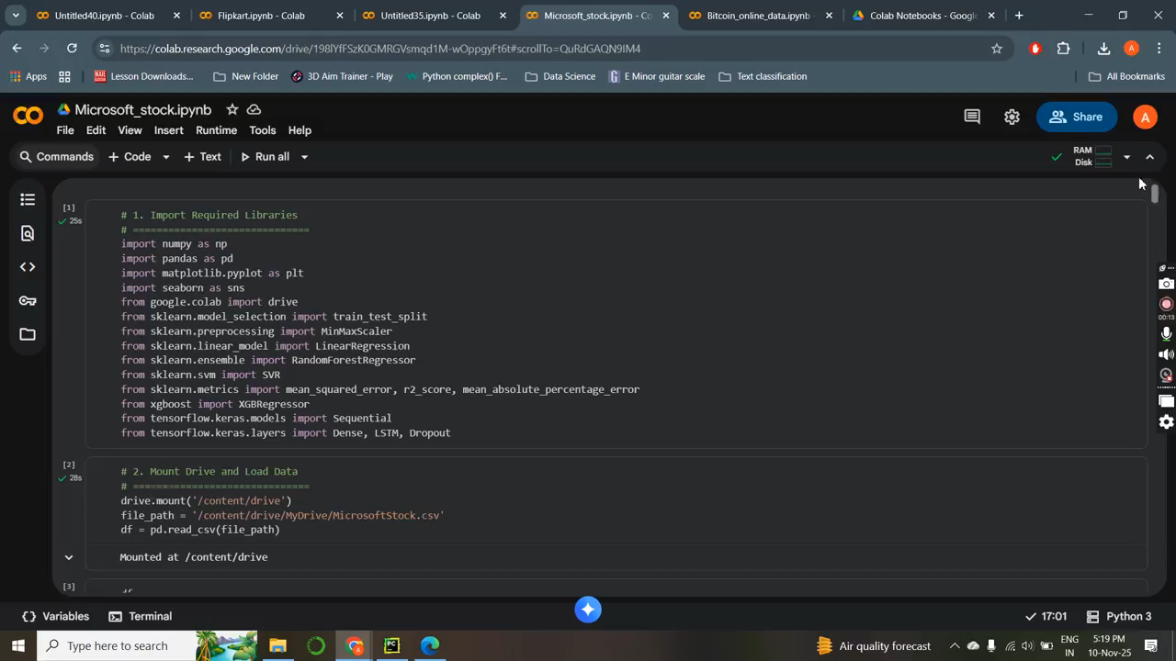
Training Model

Slide 27
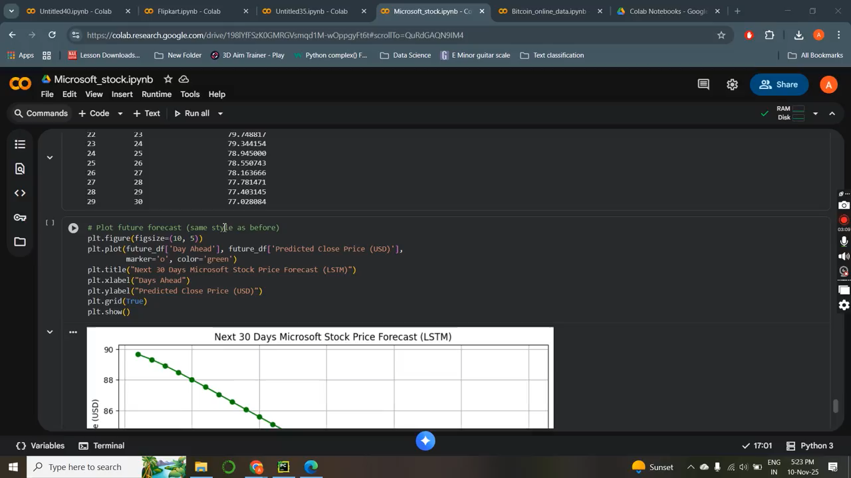
Model deployment

